Slide 1
FitnessTrack with Meal Planner
Authors: Leosbell Galvez, Wesley Del Orbe, Sabrina Valdivia Course: CIS 4951 – Capstone II Instructor: Masoud Sadjadi Date: Jan 12 – Apr 17, 2026

Slide 2



Project Summary
Fitness tracking app with integrated meal planning.
Uses Spoonacular API for meals and Back4App for exercise logs.
Provides personalized plans based on user input.

Slide 3

Problem Definition
Target Users
Students
Gym-goers
Busy individuals
People with dietary restrictions
Meal planning is time-consuming and complex.
Lack of integration with fitness tracking.
Goal: Combine nutrition and exercise in one system.

Slide 4

System Overview
High-Level Flow
Core Components
User signs up or logs in
Authentication is validated for the user session
Exercise logs are stored in back4app under the user’s unique ID
Exercise History View has full exercise logging history (data fetched from database)
Meal Plan Data is fetched from the Spoonacular API based on user preferences
Authentication System (user accounts)
Meal Planning generation Module which is API-based
Exercise Tracking/Logging Module which utilizes cloud database per user

Slide 5
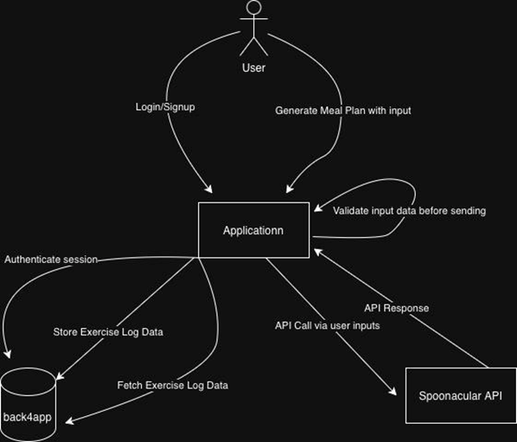
Architecture
Authentication layer for user sessions
Meal module using Spoonacular API
Exercise module using Back4App
Combined application layer

Slide 6
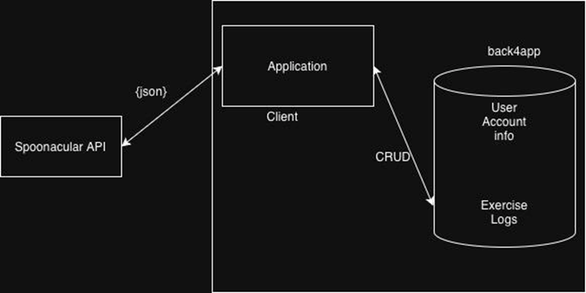
Data Flow
User logs in
Requests meal plan → API call
Receives fresh data
Exercise logs stored in database
Data merged in app

Slide 7
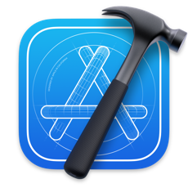

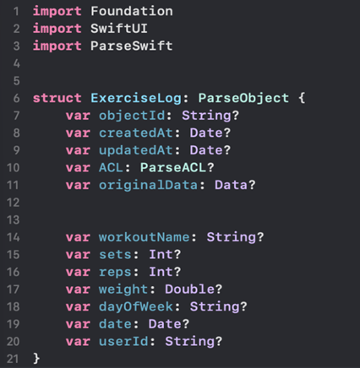
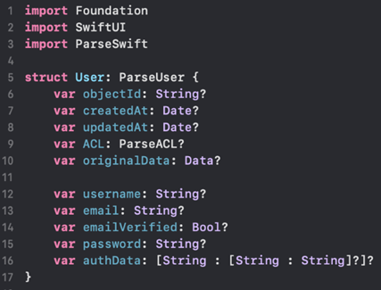
Implementation Details
Technologies Used
Stateless meal generation
Cloud-based exercise storage
Secure user sessions
Real-time API calls
Swift & SwiftUI
Spoonacular API
Back4App database
ParseSwift dependency
Key Features
User authentication
Dynamic meal generation
Exercise logging
Personalized dashboard

Slide 8
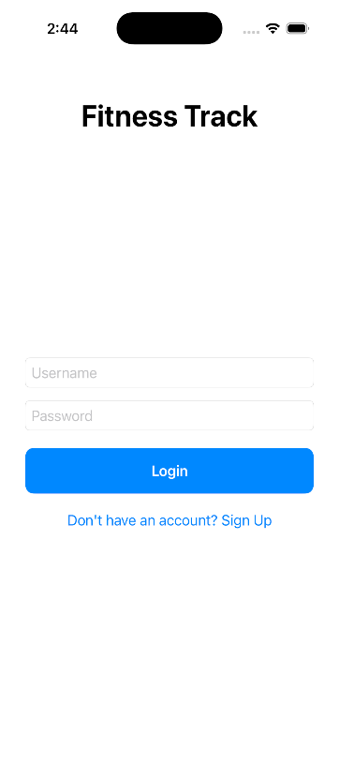
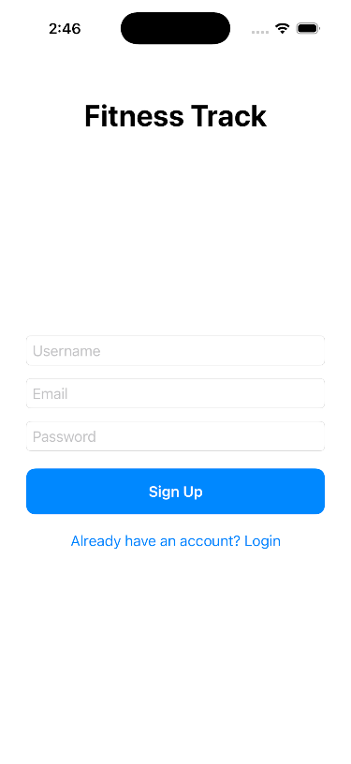
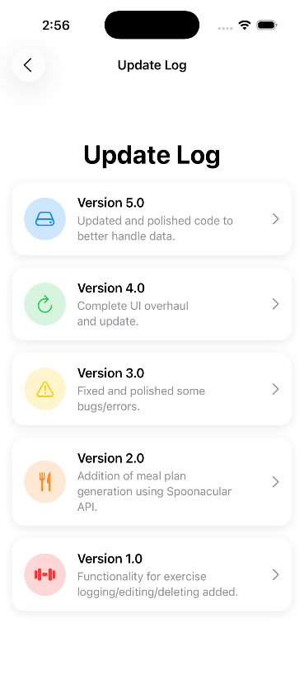
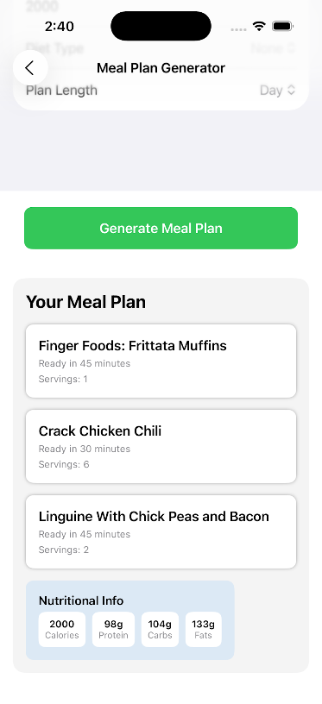
I. Testing & Evaluation

Slide 9
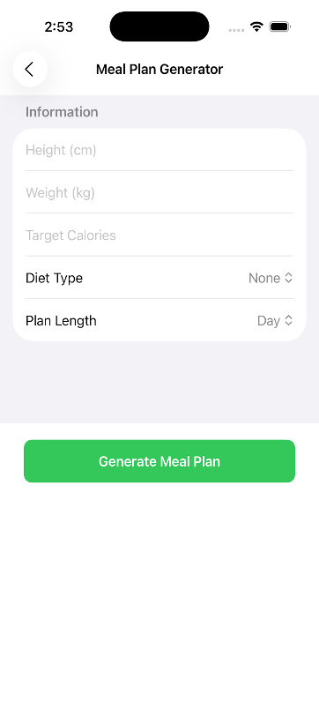
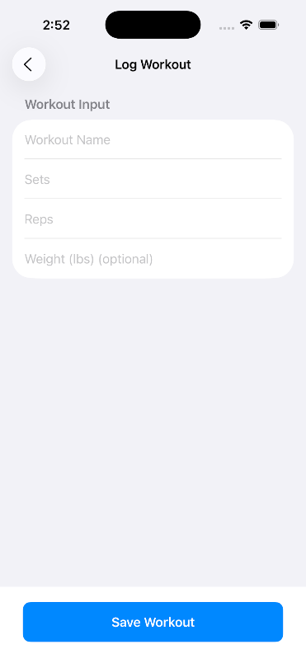
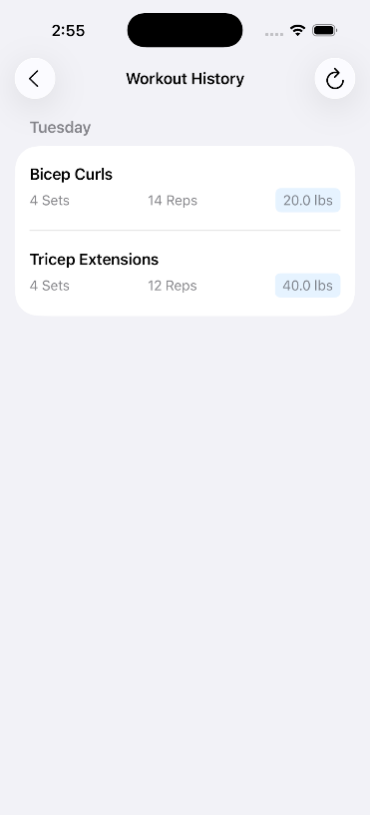
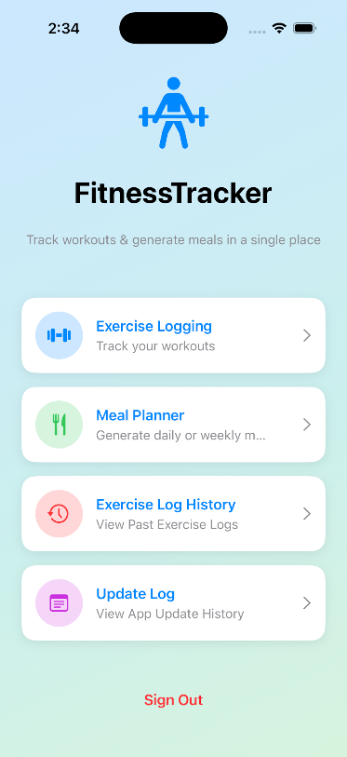
II. Testing & Evaluation

Slide 10

III. Testing & Evaluation
Test Case | Input | Expected Result | Actual Result
User Login | Valid Credentials/Login information | Session is uniquely created | Success
Generate Meal | Gluten-free diet restriction, user input | Fresh API response with a meal plan generated | Success
Regenerate Meal after Refresh | Same exact request | New unique meal plan generated | Success
Log Exercises | 4 sets of 12 reps of 60lb bicep curls | Stores in back4app correctly | Success
Switch Users | Login to a brand-new account | Different unique data shown | Success
Display Exercise Logs | Open log history tab | See accurate logs that were input by the user categorized by day/date | Success
Delete Exercise Log | Delete an exercise log by sliding left on history tab | Should complete delete all associated data from the back4app database | Success
Edit exercise log | Edit an exercise log by sliding left on history tab | Should edit all data that was re-inputted and correctly store it in the back4app | Success

Slide 11


Results
Challenges
Accurate exercise tracking
Fresh meal plans every request
Secure multi-user environment
Reliable cloud storage
Authentication layer for user sessions
Meal module using Spoonacular API
Exercise module using Back4App
Combined application layer

Slide 12

Lessons Learned
Lessons Learned
Stateless design improves freshness
Cloud databases improve persistence
Authentication is critical
Add Face ID/Touch ID
Expand nutrition APIs
Optional meal history
UI improvements
Advanced exercise tracking

Slide 13

Conclusion
Successfully built a fitness + meal planning system
Combines real-time data with persistent tracking
Scalable and user-focused solution

